Slide 1
Motion Graphs
Physics 4(A)
Notes:
Motion Graphs

Slide 2
Motion Graphs
Learning Objectives
Understand and interpret graphs related to motion
Understand the relationship between the graphs of position, velocity, and acceleration
List examples of real-time motion capture technology
Notes:
In this video you learn to understand and interpret graphs related to motion.
You will also understand the relationship between the graphs of position, velocity, and acceleration.
Finally you will also know some example of real-time motion capture technology.

Slide 3
Variables
Independent variable – the variable that does not depend on another variable
Time
Dependent variable – the variable that will be studied for change based on the independent variable
Position
Velocity
Acceleration
Notes:
The independent variable is the variable that does not depend on another variable. Typically you will see time as the independent variable.
The dependent variable is the variable that will be studied for a change based on the independent variable.
In physics, we often study how position, velocity, or acceleration might change over time

Slide 4
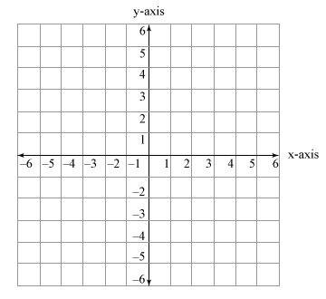
Graphs
Graphs represent the relationship between variables
Independent variable on the x-axis
Dependent variable on the y-axis
Notes:
Graphs are used to provide information in a visual format.
They represent the relationship between variables.
In most graphs the independent variable is on the horizontal x-axis and the dependent variable is on the vertical y-axis

Slide 5
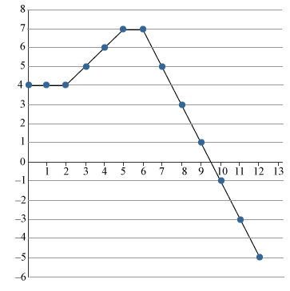
Position Graphs
Position graph – displays location relative to an origin through time
Position (m)
Time (s)
Notes:
Position graphs show the location of an object relative to an origin through time.
Here in this first section, between 0 and 2 seconds, you can see that the object started out 4 meters in the positive direction from the origin. It stayed there, stationary for 2 seconds.
In this section, between 2 and 5 seconds, it started moving away from the origin until it reached a distance 7 meters away.
The third section, between 5 and 6 seconds, shows a brief stop, for 1 second, at 7 meters away from the origin.
With the negative slope of the 4th section, from 6 seconds until the graph ends at 12 seconds, we can see that the object is moving back towards the origin, passes the origin at the x-axis at approximately 9.5 seconds and continues in the negative direction until it is 5 meters behind the origin.

Slide 6
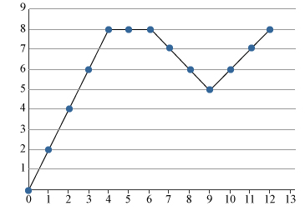
Velocity Graphs
Velocity graph – displays the rate of change in position through time
Velocity (m/s)
Time (s)
Notes:
Velocity Graphs show the rate of change in position through time.
Here in the first section, between time 0 and 4 seconds, we can see that the object is increasing its velocity over the first 4 seconds, going from 0 m/s to 8 m/s.
In the second section, between 4 and 6 seconds, the object has a constant velocity of 8 m/s.
When the velocity has a negative slope, between 6 seconds and 9 seconds, we can see that object is slowing down from 8 m/s to 5 m/s.
In the last section, from 9 seconds until the graph ends at 12 seconds, the object begins to speed up again from 5 m/s back up to 8 m/s.

Slide 7
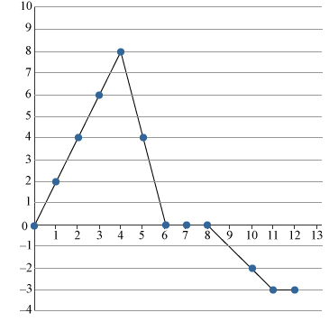
Velocity Graphs
Velocity graph – displays the rate of change in position through time
Velocity (m/s)
Time (s)
Notes:
Let’s look at another velocity graph.
Again in the first section, from 0 to 4 seconds, we can see that the object is speeding up from 0 m/s to 8 m/s.
In the second section, from 4 to 6 seconds, its velocity is decreasing. Notice that the slope of this line is more severe than the first section. It shows us that its rate of change of velocity is greater in the second section than in the first section.
In the third section, from 6 to 8 seconds, we see that the velocity of the object is 0 m/s for 2 seconds. That means it was stopped for 2 seconds.
In the fourth section, from 8 to 11 seconds, we see that the object is speeding up in the negative direction. In the last second, from 11 to 12 seconds, it holds a constant velocity of -3 m/s.
A negative velocity value like the ones shown here in the 4th and 5th sections tell us that the object is moving in the negative direction.

Slide 8
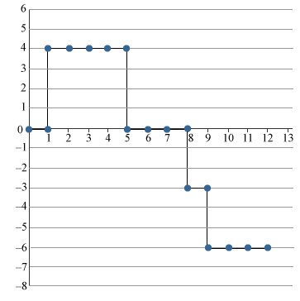
Acceleration Graphs
Acceleration graph – displays the rate of change in velocity through time
Acceleration (m/s² )
Time (s)
Notes:
Acceleration graphs show the rate of change in velocity through time.
In physics we often deal with periods of time where there is constant acceleration. This style of graph is called a step graph because it steps between data points rather than showing a gradual change between values.
In reality it would be impossible to go from an acceleration of 0 m/s² to an acceleration of 4 m/s² instantly, however, you will often see acceleration graphs depicted at step graphs.
In this first section, from 0 to 1 second, it shows that the object has an acceleration of 0 m/s². This does not mean that the object was not moving, it means that the object has a constant velocity.
Then in the second section, from seconds 1 to 5, the object has an acceleration of +4 m/s² this tells us that the velocity of the object is increasing in the positive direction.
In the next three sections you can see that we are stepping down to an acceleration of 0 m/s², then -3 m/s², then finally -6 m/s².
An acceleration of 0 m/s² between seconds 5 and 8 does not mean that the object stopped. It means that the velocity is not changing, what ever it may be.
A negative acceleration, as in the periods between 8 and 9 seconds, and between 9 and 12 seconds, can mean that the object is either slowing down or speeding up in the negative direction. The negative sign tells the direction of the acceleration, not if the object is speeding up or slowing down.

Slide 9
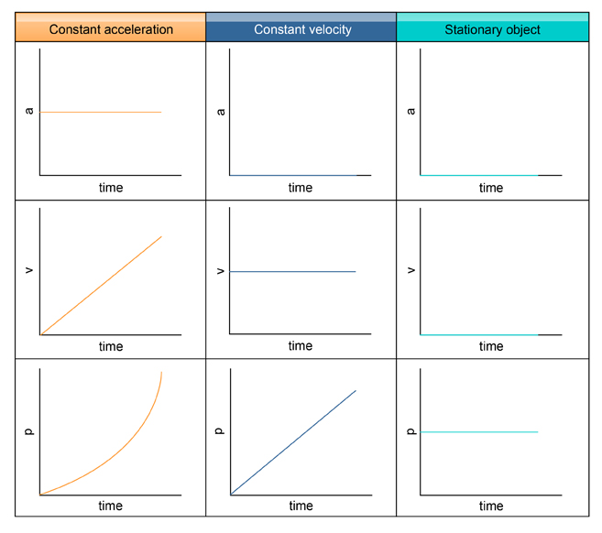
Motion Graphs
Notice the relationship between acceleration, velocity, and position graphs
Notes:
When we stack acceleration, velocity and position graphs that all deal with the motion of one object we can see an interesting relationship between the graphs.
When an object has a constant acceleration, that value is the slope of the velocity line.
And the slope of the velocity line, in turn, is the rate at which the position curve is changing.
When an object has a constant velocity, the value for acceleration is 0.
Remember that the acceleration graph gives the value of the slope of the velocity graph. If the velocity is constant, it is graphed as a horizontal line which has a slope of 0.
The value of the velocity line will be the slope of the position graph. When there is a constant velocity, notice that the change in position is linear, unlike in the constant acceleration scenario where the velocity was linear, and the position was changing exponentially.
For a stationary object you can see that both the acceleration and velocity graphs are zero while the position graph is a horizontal line indicating that position does not change as time changes.

Slide 10
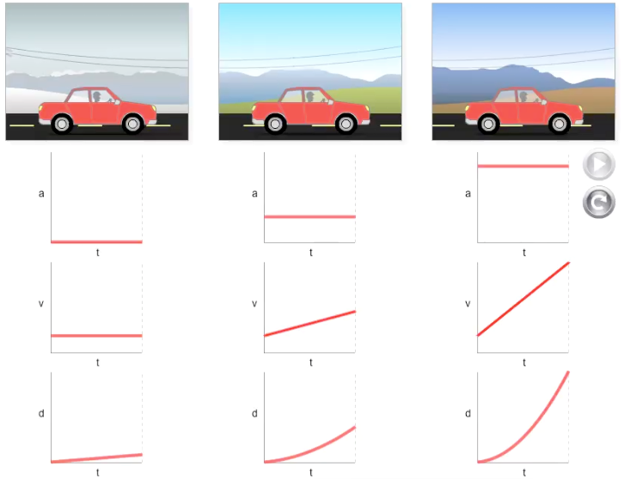
Motion Animation
Zero Acceleration
Small Acceleration
Large Acceleration
Notes:
As you watch this animation you can the see how the velocity and position graphs are impacted by different values of constant acceleration.
In the first set we have a car with no acceleration. The velocity graph remains constant and the distance traveled changes at a constant rate.
In the second set we have a relatively small acceleration. Here you can see that the velocity is changing at a constant rate and therefor the distance covered increases over time as the velocity increases.
Finally, in the last set you can see that with a high value of acceleration the rate of change of the velocity graph is also much higher and therefor the distance covered increases at a greater rate.

Slide 11
Motion Capture Devices
Photogate
A device that measures precise amounts of time
Measures the amount of time that an infrared beam is blocked
Can be used to determine the velocity of an object
Radar Gun
Measures the shift in frequency of a signal that is sent to a moving object
A device that measures the velocity of an object
Notes:
A common piece of technology used to measure motion is a photogate.
A photogate measures the amount of time that an infrared beam is blocked. It can very accurately determine how long it takes for something to pass through the gate.
A photogate is often used in a laboratory setting.
Knowing how long it takes something to pass through the gate can be used to determine the velocity of an object.
Something that you will see outside of the laboratory setting is a radar gun. A radar gun works by sending a signal from the gun to an object and registering the shift in frequency of the signal when it bounces off of the object. The radar gun can then calculate the instantaneous velocity of the object. These are very commonly used by police to monitor the speed of vehicles.

Slide 12
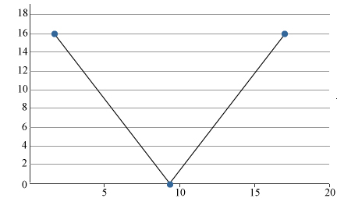
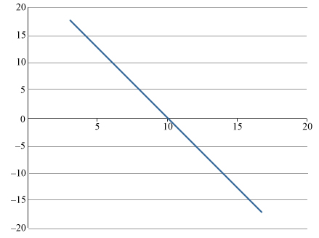
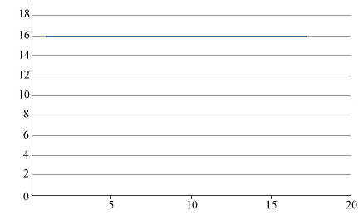
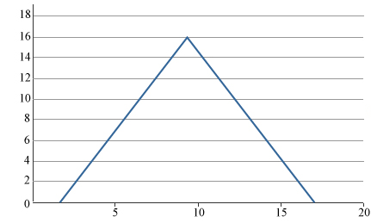
Graphing Motion Capture Data
Ex) A student uses a real-time motion detector to record the velocity of a ball thrown straight up in the air and then caught at the same location. Assume up is the positive direction. Which velocity versus time graph would resemble the correct velocity graph of the ball?
1
3
Velocity (m/s)
Velocity (m/s)
Time (s)
Time (s)
2
4
Velocity (m/s)
Velocity (m/s)
Time (s)
Time (s)
Notes:
Let us look at an example that asks us to determine the correct graph based on a written scenario.
A student uses a real-time motion detector to record the velocity of a ball thrown straight up in the air and then caught at the same location from where it was thrown. We will assume up is the positive direction. Which graph below would resemble the correct velocity graph of the ball?
Let’s look at what each graph is telling us about the velocity of the object and determine the correct graph for this situation.
In this first graph it shows an object with a large velocity that decreases linearly until it reaches zero. Then the velocity increase at the same rate linearly until it reaches the same velocity at which it started.
In the second graph, we see a graph that shows us a constant velocity of 16 m/s throughout the entire graph.
The third graph shows a large inital velocity that decreases linearly and when it crosses 0 m/s it begins to increase its velocity in the negative direction until it reaches the opposite sign of its initial velocity.
The last option shows an object with a velocity of 0 m/s at the start that increases linearly until it reaches a velocity of 16 m/s then decreases velocity linearly until it reaches 0 m/s again.
It might be tempting to pick the first graph. It seems to make sense that the object would start out fast and slow down to zero at the top of the throw then speed up the same way on the way back down. But we need to remember that velocity is a vector. It shows both magnitude and direction. And to show the change in direction we need to look for a negative velocity. The third graph correctly depicts this scenario. It shows the ball being thrown at a velocity of 16 m/s, slowing down to the top of its path and then speeding up in the opposite direction.

Slide 13
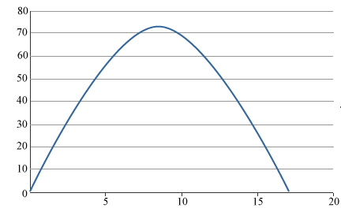
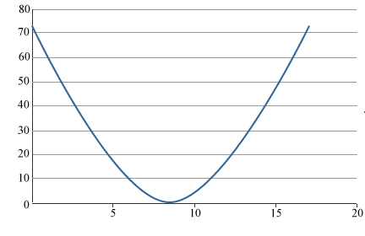
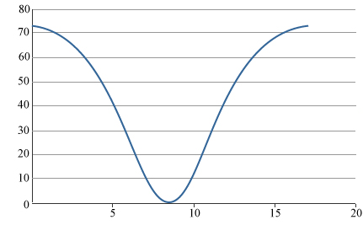
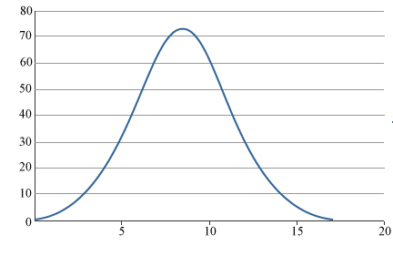
Graphing Motion Capture Data
Ex) In the same scenario, what would the position versus time graph look like if up is positive?
1
3
Position (m)
Position (m)
Time (s)
Time (s)
2
4
Position (m)
Position (m)
Time (s)
Time (s)
Notes:
In this same scenario, of throwing a ball into the air straight up and catching it a the same position that it was thrown from, what would the position versus time graph look like if we assumed up to be positive?
Let’s examine the graphs.
The first and fourth graph both show an object moving away from the origin and then returning to the origin. The second and third graphs show an object that is starting far away from the origin heading towards the origin and then moving away from the origin.
Since the ball is moving away from the person throwing it, the origin, and returning we know that the second and third graphs are incorrect. We can focus on the first and fourth graph in this scenario.
The first half of the first graph is curving downward. This means that the position is changing fast at the beginning and then decreases the rate of its change as the object moves away from the origin. Then in the second half of the graph is is also curved downward. This means that its position is changing more slowly at the start of the path back to the origin and speeds up on the way down.
In the first half of the fourth graph we can see that it is curved upward. This means that the rate at which the position is changing is increasing as gets further from the origin. And on its return trip with a curve upward it shows that the rate of change in the position is slowing down on the way down. It doesn’t make much sense for an object to slow down as it falls down from the top of an arc.
The first graph is the correct depiction of our scenario.

Slide 14
Graphing Motion Capture Data
Ex) A police officer uses a radar gun to show the instantaneous velocity of a car. The table shows the data collected from the radar gun. What conclusions can be drawn from the data and what graphs can be created?
Time (s) | Velocity (mph)
0 | 87
1 | 87
2 | 87
3 | 87
4 | 82
5 | 77
6 | 72
7 | 67
8 | 62
9 | 62
10 | 62
Conclusions
During time 0 s to 10 s | Slowed down from 87 mph to 62 mph
During time 0 s to 3 s | Constant velocity of 87 mph (0 acceleration)
During time 3 s to 8 s | Constant acceleration of -5 mph/s
During time 8 s to 10 s | Constant velocity of 62 mph (0 acceleration)
Notes:
In this example a police officer uses a radar gun to show the instantaneous velocity of a car. If the following table shows the data collected from the radar gun, what conclusions can be drawn from the data and what graphs can be created?
The table shows us a car that was traveling at 87 miles per hour and then slowed to 62 miles per hour.
What conclusions can we draw from this data?
First we can see that from 0 to 10 seconds the car slowed from a velocity of 87 mph to 62 mph.
Also we can see that for the time from 0-3 seconds the car has a constant velocity of 87 mph.
then during the time frame of 3 second to 8 seconds the car slowed down with a constant acceleration of -5 mph/s. This conclusion can be reached by taking the difference between the velocities and dividing them by the time between each data point.
For example. 82 mph – 87 mph divided by 1 second is -5 mph/s. You can see that there is a decrease of 5 mph each second. Therefor we know that the acceleration is constant.
And finally we can see that for the time period for 8 seconds to 10 seconds the car held a constant velocity of 62 mph.
We will show the graphs that can be created on the next slide.

Slide 15
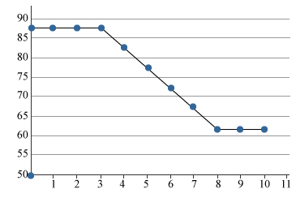
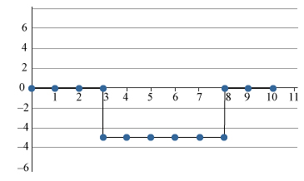
Graphing Motion Capture Data
Time (s) | Velocity (mph)
0 | 87
1 | 87
2 | 87
3 | 87
4 | 82
5 | 77
6 | 72
7 | 67
8 | 62
9 | 62
10 | 62
Velocity (mph)
Time (s)
Acceleration (mph/s)
Time (s)
Notes:
We are now going to graph the data in the chart.
First, you can see the velocity graph of the data. Notice that this quickly illustrates many of the conclusions we came up with from the data.
The initial horizontal slope represents the the initial constant velocity of 87 mph.
We can see the velocity changing from the 3rd second to the 8th second to a speed of 62 and then the velocity holding constant at 62 miles per hour for the remainder of the time. Notice how the graph has a constant negative slop between 3 seconds and 8 seconds.
We can also create an acceleration graph using the information in the velocity graph.
When the velocity is constant we know that the acceleration is 0. Then when the car is changing velocity it must have an acceleration. Remember that the velocity graph describes the value of the acceleration. To determine the slope of the velocity graph from seconds three to eight we take the rise divided by the run. In this case the value dropped by 25 mph in 5 seconds. The slope of this section of the velocity graph is -5 mph/s.
The slope of the velocity line here is the value of the acceleration, so the value of the acceleration between three seconds and eight seconds is -5 mph/s. In the last portion of the graph the acceleration is back to 0 because the velocity of the car was constant.

Slide 16
Motion Graphs
Learning Objectives
Understand and interpret graphs related to motion
Understand the relationship between the graphs of position, velocity, and acceleration
List examples of real-time technology used to capture motion
Notes:
You should now have better understanding of motion graphs and how to interpret them.
You should understand the relationship between position, velocity, and acceleration graphs. The slope of one graph can be used to determine the shape of another.
You should also know a few examples of real-time technology used to capture motion.

